Slide 1
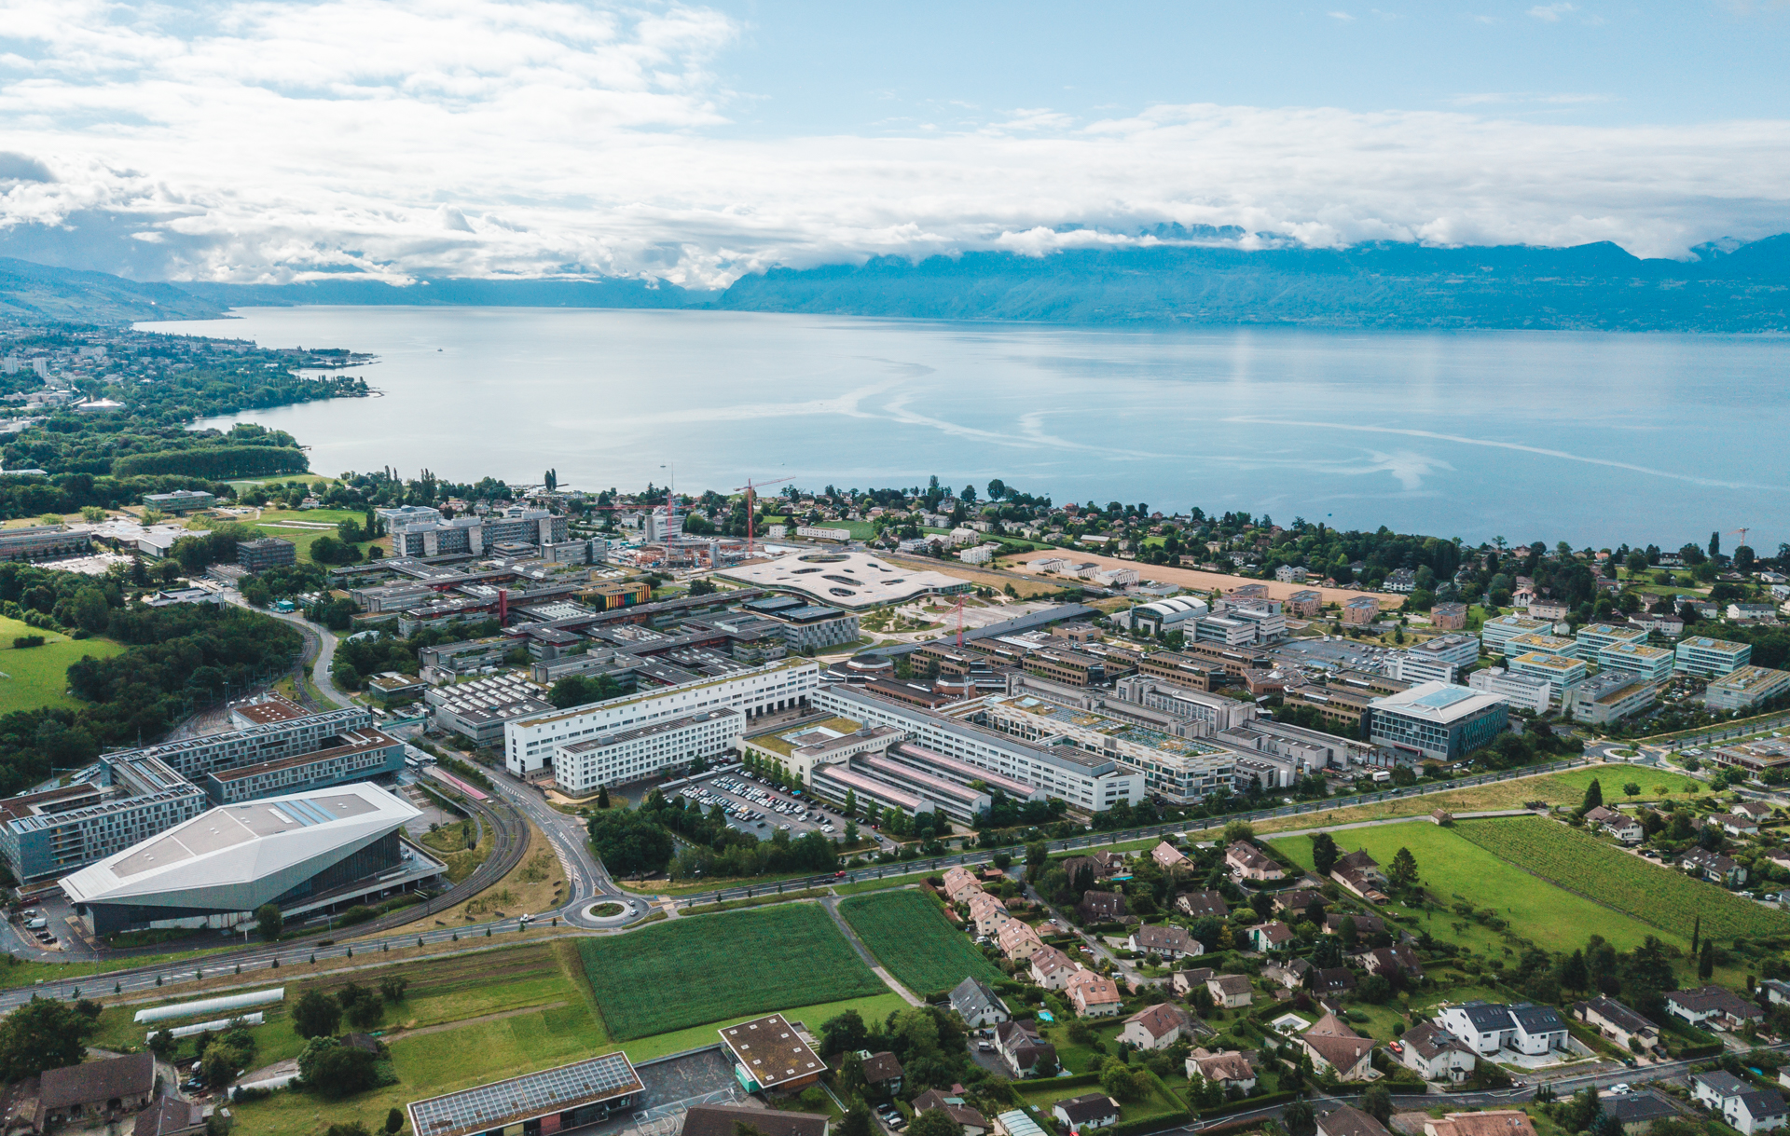
Machine Learning Methods for Robust Uncertainty Quantification and Controller Approximation
Emilio Tanowe Maddalena’s Ph.D. exam
23.03.2023

Slide 2


Jury composition
Prof. Giancarlo Ferrari-Trecate – Jury President
Prof. Roy Smith – Internal Examiner
Prof. Sandra Hirche – External Examiner
Prof. Lorenzo Fagiano – Exaternal Examiner
About the doctoral candidate
Emilio Tanowe Maddalena, Brazilian and Italian
Thesis director: prof. Colin Neil Jones
PhD candidate within the EPFL EDEE Doctoral School from Sep. 2018 – Mar. 2023
Notes:
Mathematically,
Let’s assume you have an underlying function that you want to model, F.
You perform some experiments, collecting some pairs of (x,y), where the ys carry information about F are corrupted by additive noise, which is distributed Normally with zero mean and some standard deviation SIGMA.
GPs are defined following Bayesian statistics principles. Firstly, you specify what is known as a PRIOR for unknown values of F. Something that encapsulates your personal beliefs about it – and yes, that’s subjective.
This PRIOR must be in the form of a Gaussian as well, where you can specify its mean and covariance.
Next, in combination with your data, you apply Baye’s rule (Baye’s theorem) to derive the POSTERIOR expression for F – which then defines your Gaussian process.
The beauty of GPs is that this step can be carried out analytically, and there’s almost no other setting in which this is true. Which means, there are no approximations being made when deriving GPs!
If all of this is unfamiliar to you, just remember the following two equations.
The first defined your nominal predictions, whereas the second will give you the level of uncertainty for that same prediction.
In other words, if we come back to this picture…
- - - -
y_i = f(x_i) + \varepsilon_i, \ i=1,\dots,N
\epsilon_i \sim \mathcal{N}(0,\sigma)
f(x) \sim \mathcal{N}(m(x),k(x))
p(f) = \mathcal{N}(m(x),k(x))
p(f\,|y) = \mathcal{N}(\mu(x),\text{var}(x))
\mu(x) &= m(x) + k_X(x)^\top (K_{XX}+\sigma^2I)^{-1}(y-m_X)
\text{var}(x) &= k(x,x) - k_X(x)^\top (K_{XX}+\sigma^2I)^{-1} k_X(x)

Slide 3
Agenda
PART 1
PART 2
Building temperature control through Gaussian process and model predictive control
Safely learning with kernels
PART 3
PART 4
Learning MPC controllers with pQP neural networks
Final remarks
Notes:
Mathematically,
Let’s assume you have an underlying function that you want to model, F.
You perform some experiments, collecting some pairs of (x,y), where the ys carry information about F are corrupted by additive noise, which is distributed Normally with zero mean and some standard deviation SIGMA.
GPs are defined following Bayesian statistics principles. Firstly, you specify what is known as a PRIOR for unknown values of F. Something that encapsulates your personal beliefs about it – and yes, that’s subjective.
This PRIOR must be in the form of a Gaussian as well, where you can specify its mean and covariance.
Next, in combination with your data, you apply Baye’s rule (Baye’s theorem) to derive the POSTERIOR expression for F – which then defines your Gaussian process.
The beauty of GPs is that this step can be carried out analytically, and there’s almost no other setting in which this is true. Which means, there are no approximations being made when deriving GPs!
If all of this is unfamiliar to you, just remember the following two equations.
The first defined your nominal predictions, whereas the second will give you the level of uncertainty for that same prediction.
In other words, if we come back to this picture…
- - - -
y_i = f(x_i) + \varepsilon_i, \ i=1,\dots,N
\epsilon_i \sim \mathcal{N}(0,\sigma)
f(x) \sim \mathcal{N}(m(x),k(x))
p(f) = \mathcal{N}(m(x),k(x))
p(f\,|y) = \mathcal{N}(\mu(x),\text{var}(x))
\mu(x) &= m(x) + k_X(x)^\top (K_{XX}+\sigma^2I)^{-1}(y-m_X)
\text{var}(x) &= k(x,x) - k_X(x)^\top (K_{XX}+\sigma^2I)^{-1} k_X(x)

Slide 4
Part 1
Safely learning with kernels
Published works:
Scharnhorst, Maddalena, Jiang, Jones. “Robust uncer- tainty bounds in reproducing kernel Hilbert spaces: A convex optimization approach.” IEEE Transactions on Automatic Control (2022).
Maddalena, Scharnhorst, Jones. “Deterministic error bounds for kernel-based learning techniques under bounded noise.” Automatica (2021).
Maddalena, Scharnhorst, Jiang, Jones. “KPC: Learning- based model predictive control with deterministic guarantees.” L4DC (2021).
Notes:
Mathematically,
Let’s assume you have an underlying function that you want to model, F.
You perform some experiments, collecting some pairs of (x,y), where the ys carry information about F are corrupted by additive noise, which is distributed Normally with zero mean and some standard deviation SIGMA.
GPs are defined following Bayesian statistics principles. Firstly, you specify what is known as a PRIOR for unknown values of F. Something that encapsulates your personal beliefs about it – and yes, that’s subjective.
This PRIOR must be in the form of a Gaussian as well, where you can specify its mean and covariance.
Next, in combination with your data, you apply Baye’s rule (Baye’s theorem) to derive the POSTERIOR expression for F – which then defines your Gaussian process.
The beauty of GPs is that this step can be carried out analytically, and there’s almost no other setting in which this is true. Which means, there are no approximations being made when deriving GPs!
If all of this is unfamiliar to you, just remember the following two equations.
The first defined your nominal predictions, whereas the second will give you the level of uncertainty for that same prediction.
In other words, if we come back to this picture…
- - - -
y_i = f(x_i) + \varepsilon_i, \ i=1,\dots,N
\epsilon_i \sim \mathcal{N}(0,\sigma)
f(x) \sim \mathcal{N}(m(x),k(x))
p(f) = \mathcal{N}(m(x),k(x))
p(f\,|y) = \mathcal{N}(\mu(x),\text{var}(x))
\mu(x) &= m(x) + k_X(x)^\top (K_{XX}+\sigma^2I)^{-1}(y-m_X)
\text{var}(x) &= k(x,x) - k_X(x)^\top (K_{XX}+\sigma^2I)^{-1} k_X(x)

Slide 5
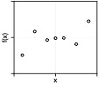
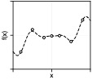
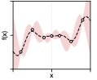
Introduction
The final goal: carry out regression with hard error-bounds.
Motivation: deterministic, robust analysis and control of dynamical systems.
What family of functions to consider?
What complexity measure to use?
How to estimate uncertainty?
Notes:
Goal: introduce kernels and RKHSs

Slide 6
Introduction
Kernels and their RKHSs
Notes:
Goal: introduce kernels and RKHSs

Slide 7
Introduction
Kernels and their RKHSs
Notes:
Goal: introduce kernels and RKHSs

Slide 8
Introduction
Kernels and their RKHSs
Not unique!
Unique!
Notes:
Goal: introduce kernels and RKHSs

Slide 9
Introduction
Kernels and their RKHSs
Pre-Hilbert space
The actual Hilbert space
The inner-product is defined as
More rigorously, a consistent and valid inner-product has to be defined on the superset. Also, the closure of a set is always closed.

Slide 10
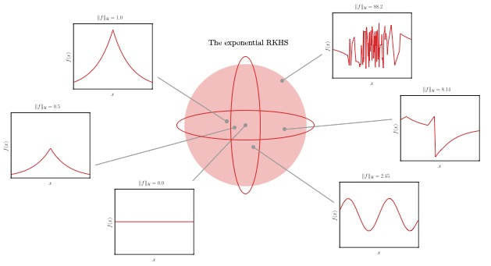
Introduction
Kernels and their RKHSs
The RKHS of certain PD kernels is dense in the space of continuous functions!
Notes:
Goal: introduce kernels and RKHSs

Slide 11
Results
Hard error-bounds in a kernelized setting
Notes:
Let Assumptions~\ref{as:kernel_spd_compact_X}-\ref{as.norm_bound} hold with $\bar \delta = 0$. Let $s$ be the minimum-norm interpolant $s(x)=\alpha^\top K_{Xx}, \alpha = y^\top K_{XX}^{-1}$. Then, for any $x \in \mathcal{X}$
\label{prop.noise_free_bound}
\begin{empheq}[box={\mymathbox[colback=black!2,drop small lifted shadow, sharp corners]}]{equation}
\label{eq.noise_free_bounds}
\left|s(x) - f^\star(x)\right| \leq P_X(x) \sqrt{\Gamma^2 - \rknorm{s}^2}
\end{empheq}

Slide 12
Results
Hard error-bounds in a kernelized setting
Notes:
Let Assumptions~\ref{as:kernel_spd_compact_X}-\ref{as.norm_bound} hold with $\bar \delta = 0$. Let $s$ be the minimum-norm interpolant $s(x)=\alpha^\top K_{Xx}, \alpha = y^\top K_{XX}^{-1}$. Then, for any $x \in \mathcal{X}$
\label{prop.noise_free_bound}
\begin{empheq}[box={\mymathbox[colback=black!2,drop small lifted shadow, sharp corners]}]{equation}
\label{eq.noise_free_bounds}
\left|s(x) - f^\star(x)\right| \leq P_X(x) \sqrt{\Gamma^2 - \rknorm{s}^2}
\end{empheq}

Slide 13
Results
Model-free uncertainty bounds in a kernelized setting
Notes:
Let Assumptions~\ref{as:kernel_spd_compact_X}-\ref{as.norm_bound} hold with $\bar \delta = 0$. Let $s$ be the minimum-norm interpolant $s(x)=\alpha^\top K_{Xx}, \alpha = y^\top K_{XX}^{-1}$. Then, for any $x \in \mathcal{X}$
\label{prop.noise_free_bound}
\begin{empheq}[box={\mymathbox[colback=black!2,drop small lifted shadow, sharp corners]}]{equation}
\label{eq.noise_free_bounds}
\left|s(x) - f^\star(x)\right| \leq P_X(x) \sqrt{\Gamma^2 - \rknorm{s}^2}
\end{empheq}

Slide 14
Results
Model-free uncertainty bounds in a kernelized setting
Notes:
Let Assumptions~\ref{as:kernel_spd_compact_X}-\ref{as.norm_bound} hold with $\bar \delta = 0$. Let $s$ be the minimum-norm interpolant $s(x)=\alpha^\top K_{Xx}, \alpha = y^\top K_{XX}^{-1}$. Then, for any $x \in \mathcal{X}$
\label{prop.noise_free_bound}
\begin{empheq}[box={\mymathbox[colback=black!2,drop small lifted shadow, sharp corners]}]{equation}
\label{eq.noise_free_bounds}
\left|s(x) - f^\star(x)\right| \leq P_X(x) \sqrt{\Gamma^2 - \rknorm{s}^2}
\end{empheq}

Slide 15
Results
Model-free uncertainty bounds in a kernelized setting
Notes:
Let Assumptions~\ref{as:kernel_spd_compact_X}-\ref{as.norm_bound} hold with $\bar \delta = 0$. Let $s$ be the minimum-norm interpolant $s(x)=\alpha^\top K_{Xx}, \alpha = y^\top K_{XX}^{-1}$. Then, for any $x \in \mathcal{X}$
\label{prop.noise_free_bound}
\begin{empheq}[box={\mymathbox[colback=black!2,drop small lifted shadow, sharp corners]}]{equation}
\label{eq.noise_free_bounds}
\left|s(x) - f^\star(x)\right| \leq P_X(x) \sqrt{\Gamma^2 - \rknorm{s}^2}
\end{empheq}

Slide 16
Examples

Slide 17
Examples
Control sequence validation
Constraints
CSTR system
Desired equilibrium
A KRR model was learned from data and a certainty-equivalence-based OCP was designed to drive the system close to the desired equilibrium from 4 distinct initial conditions, yielding (open-loop) sequences of control actions…
How to verify if these will lead to constraints violations?
Notes:
Let Assumptions~\ref{as:kernel_spd_compact_X}-\ref{as.norm_bound} hold with $\bar \delta = 0$. Let $s$ be the minimum-norm interpolant $s(x)=\alpha^\top K_{Xx}, \alpha = y^\top K_{XX}^{-1}$. Then, for any $x \in \mathcal{X}$
\label{prop.noise_free_bound}
\begin{empheq}[box={\mymathbox[colback=black!2,drop small lifted shadow, sharp corners]}]{equation}
\label{eq.noise_free_bounds}
\left|s(x) - f^\star(x)\right| \leq P_X(x) \sqrt{\Gamma^2 - \rknorm{s}^2}
\end{empheq}

Slide 18
Examples
Control sequence validation
Phase portraits of the CSTR system under the same control inputs, but different uncertainty quantification techniques.
Notes:
Let Assumptions~\ref{as:kernel_spd_compact_X}-\ref{as.norm_bound} hold with $\bar \delta = 0$. Let $s$ be the minimum-norm interpolant $s(x)=\alpha^\top K_{Xx}, \alpha = y^\top K_{XX}^{-1}$. Then, for any $x \in \mathcal{X}$
\label{prop.noise_free_bound}
\begin{empheq}[box={\mymathbox[colback=black!2,drop small lifted shadow, sharp corners]}]{equation}
\label{eq.noise_free_bounds}
\left|s(x) - f^\star(x)\right| \leq P_X(x) \sqrt{\Gamma^2 - \rknorm{s}^2}
\end{empheq}

Slide 19
Examples
State trajectories of the CSTR system under the same control inputs, but with different uncertainty quantification techniques.
Notes:
Let Assumptions~\ref{as:kernel_spd_compact_X}-\ref{as.norm_bound} hold with $\bar \delta = 0$. Let $s$ be the minimum-norm interpolant $s(x)=\alpha^\top K_{Xx}, \alpha = y^\top K_{XX}^{-1}$. Then, for any $x \in \mathcal{X}$
\label{prop.noise_free_bound}
\begin{empheq}[box={\mymathbox[colback=black!2,drop small lifted shadow, sharp corners]}]{equation}
\label{eq.noise_free_bounds}
\left|s(x) - f^\star(x)\right| \leq P_X(x) \sqrt{\Gamma^2 - \rknorm{s}^2}
\end{empheq}

Slide 20
Conclusion
Final remarks and future investigations
Kernel-based error-bounds were extended to handle noisy data
Novel uncertainty quantification techniques were put forward
Directions for possible future investigations include:
Establishing continuity properties for and
Covering the case of uncertain inputs
Devising a kernel-based MPC algorithm that is optimistic rather than pessimistic
Notes:
Let Assumptions~\ref{as:kernel_spd_compact_X}-\ref{as.norm_bound} hold with $\bar \delta = 0$. Let $s$ be the minimum-norm interpolant $s(x)=\alpha^\top K_{Xx}, \alpha = y^\top K_{XX}^{-1}$. Then, for any $x \in \mathcal{X}$
\label{prop.noise_free_bound}
\begin{empheq}[box={\mymathbox[colback=black!2,drop small lifted shadow, sharp corners]}]{equation}
\label{eq.noise_free_bounds}
\left|s(x) - f^\star(x)\right| \leq P_X(x) \sqrt{\Gamma^2 - \rknorm{s}^2}
\end{empheq}

Slide 21
Part 2
Building temperature control through Gaussian process and model predictive control
Published works:
Di Natale, Lian, Maddalena, Shi, Jones. “Lessons learned from data-driven building control experiments: Contrasting Gaussian process-based MPC, bilevel DeePC, and deep reinforcement learning.” CDC (2022).
Maddalena, Müller, Dos Santos, Salzmann, Jones. “Experimental data-driven model predictive control of a hospital HVAC system during regular use.” Energy and Buildings (2022).
Maddalena, Lian, Jones. “Data-driven methods for building control—A review and promising future directions.” Control Engineering Practice (2020).
Notes:
Mathematically,
Let’s assume you have an underlying function that you want to model, F.
You perform some experiments, collecting some pairs of (x,y), where the ys carry information about F are corrupted by additive noise, which is distributed Normally with zero mean and some standard deviation SIGMA.
GPs are defined following Bayesian statistics principles. Firstly, you specify what is known as a PRIOR for unknown values of F. Something that encapsulates your personal beliefs about it – and yes, that’s subjective.
This PRIOR must be in the form of a Gaussian as well, where you can specify its mean and covariance.
Next, in combination with your data, you apply Baye’s rule (Baye’s theorem) to derive the POSTERIOR expression for F – which then defines your Gaussian process.
The beauty of GPs is that this step can be carried out analytically, and there’s almost no other setting in which this is true. Which means, there are no approximations being made when deriving GPs!
If all of this is unfamiliar to you, just remember the following two equations.
The first defined your nominal predictions, whereas the second will give you the level of uncertainty for that same prediction.
In other words, if we come back to this picture…
- - - -
y_i = f(x_i) + \varepsilon_i, \ i=1,\dots,N
\epsilon_i \sim \mathcal{N}(0,\sigma)
f(x) \sim \mathcal{N}(m(x),k(x))
p(f) = \mathcal{N}(m(x),k(x))
p(f\,|y) = \mathcal{N}(\mu(x),\text{var}(x))
\mu(x) &= m(x) + k_X(x)^\top (K_{XX}+\sigma^2I)^{-1}(y-m_X)
\text{var}(x) &= k(x,x) - k_X(x)^\top (K_{XX}+\sigma^2I)^{-1} k_X(x)

Slide 22
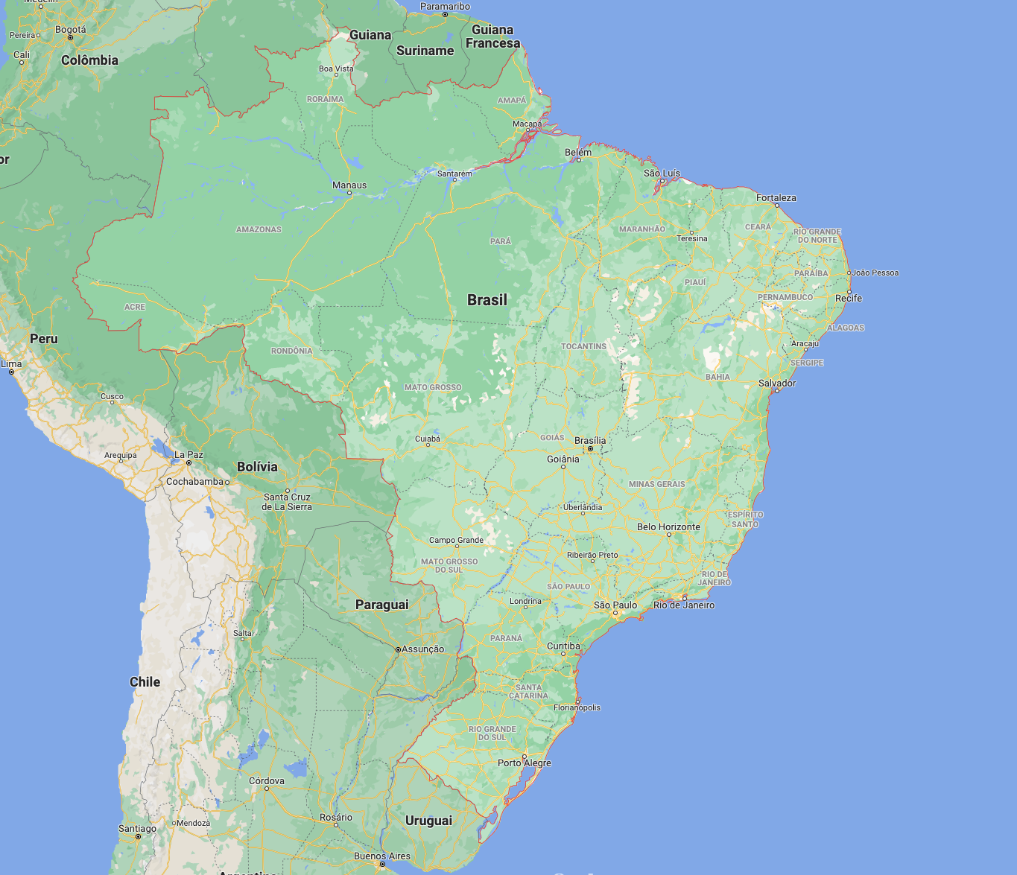
System overview
Notes:
We’ll now switch gears and explore the control problem a bit.
I will describe a building and its HVAC system located in Campo Grande, Mato Grosso do Sul, Brazil. BTW, HVAC stands for heating, ventilation and air-conditioning.
Okay. Here’s Campo Grande, a city located in the central-western part of the country.

Slide 23
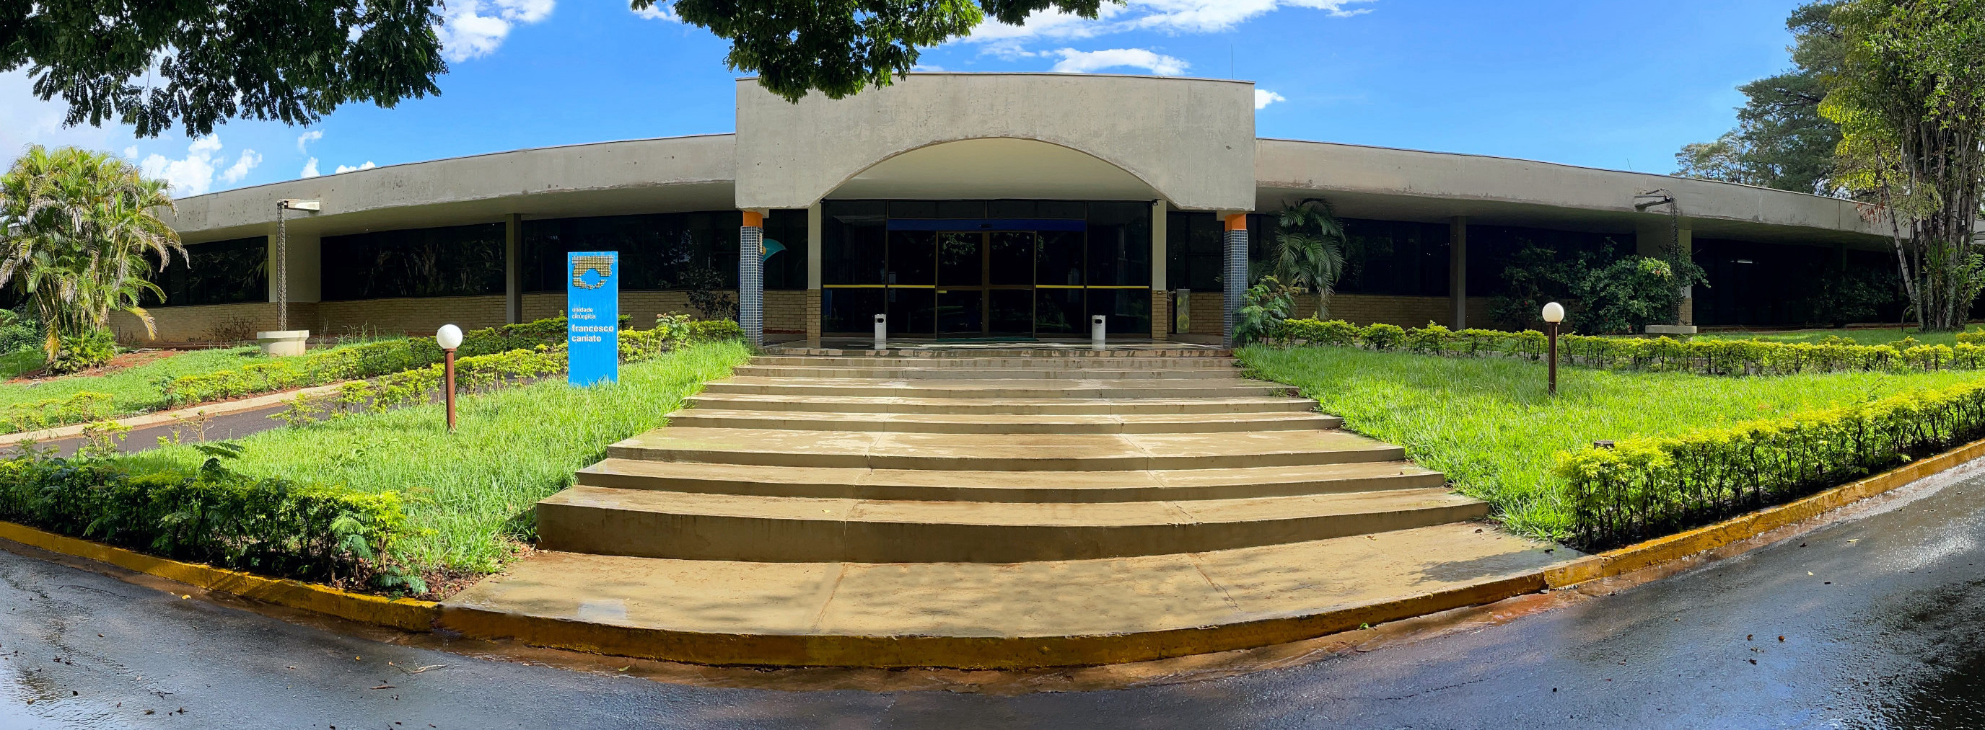
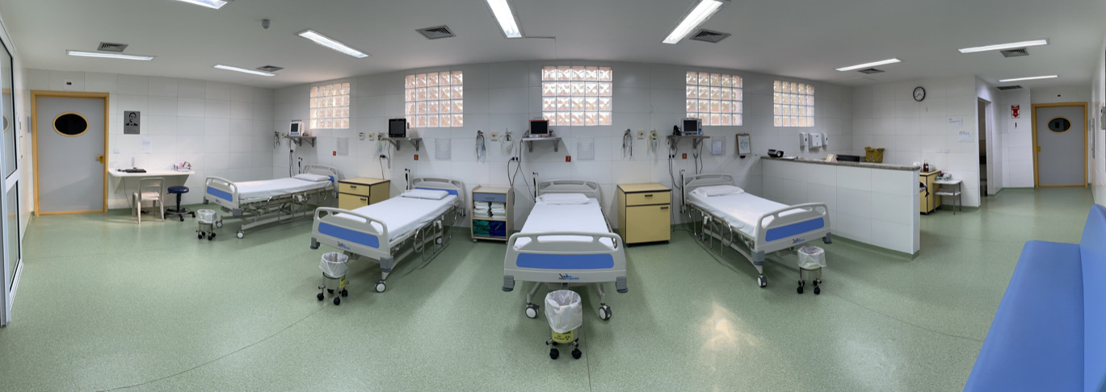
System overview
Notes:
A couple of years ago we established this partnership with a public hospital named Hospital São Julião, where we agreed to deploy a number of sensor networks to monitor the local HVAC plant and propose new control strategies for it.
The hospital is a large complex with over 30 buildings, but we were concerned with only the surgery center, the one in the top photo.
More specifically, the ophthalmology section of the surgery center, located on its West end.
There are two operating rooms and one waiting room, so three thermal zones in total.
There are no radiators in there, and cooling is achieved by pumping clean cold air into the zones through these outlets installed on the ceiling. That’s what we call a forced-air system.
How is this air produced?

Slide 24
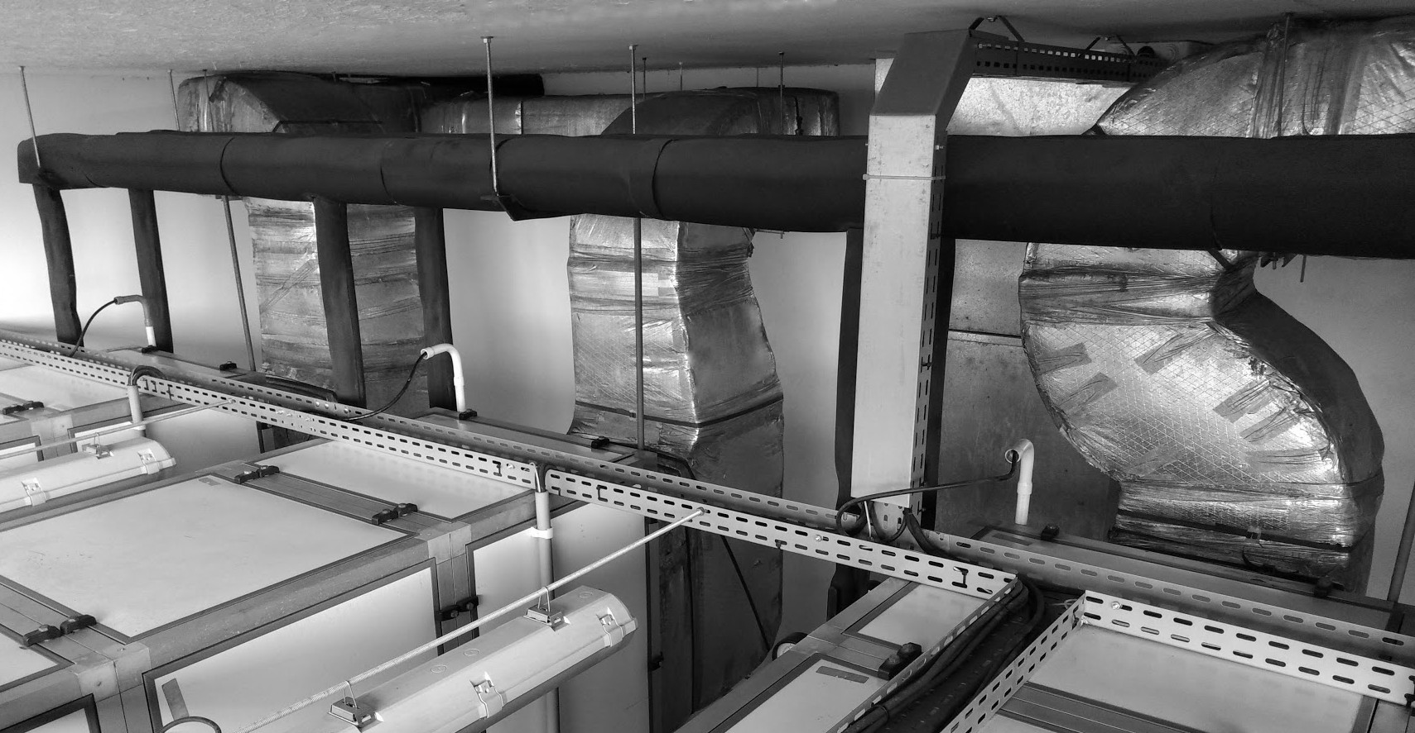
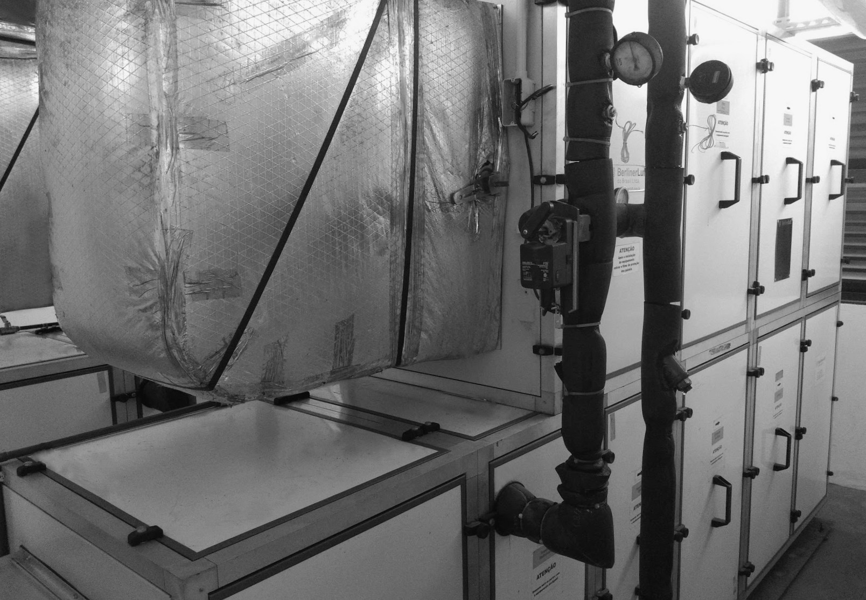
System overview
Notes:
WELL, right to the side of these three rooms, you have a separate space where the HVAC plant is.
It’s composed of air-handling units (aka AHUs). There are large fans inside of them, as well as particle and bacteria filters to purify the air, and coils to bring down the temperature. These equipment collect air from the external environment and treat it beofre pumping it into the rooms.
Through these coils runs cold water supplied by a central chiller. The flow of water can be regulated by opening and closing the valves you see in this picture.
Long story short, if you change the position of the valves, you affect the indoor climate.
//
Let’s focus on this diagram. The chiller provides cold water to the AHUs, the AHUs provide cold air to the rooms. The rooms follow their dynamics, exchanging thermal energy among themselves and with the rest of the building.
As for the computers in ths system, we have four of them.
One local controller sitting on top of each AHU, and one general purpose computer stored in the Waiting room, inside a small rack, it runs all the complicated code, hosts a database and communicates with the external world whenever needed.

Slide 25
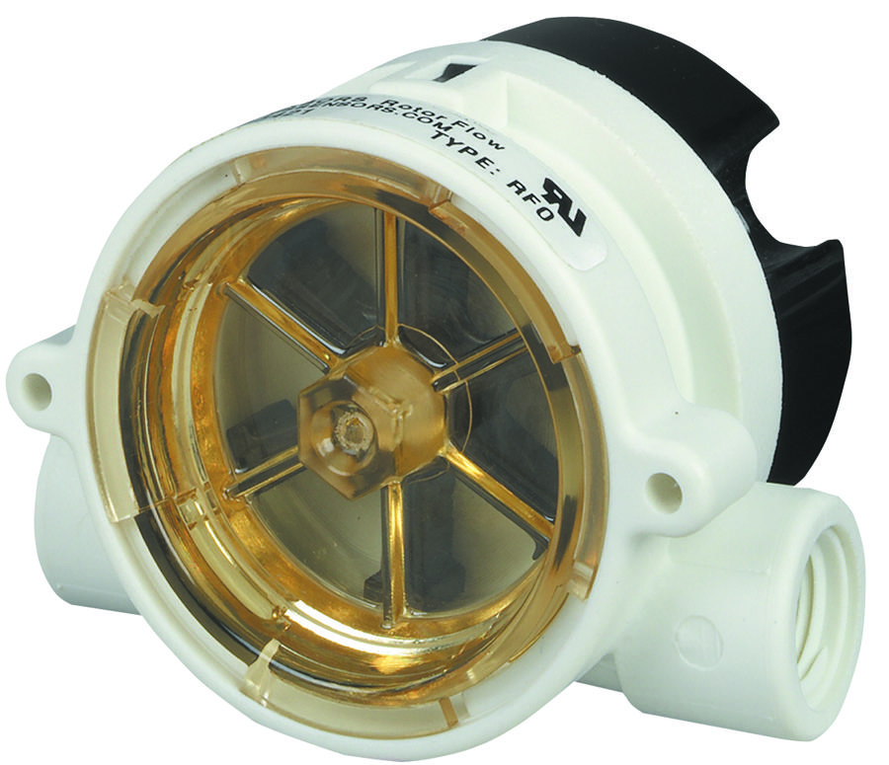
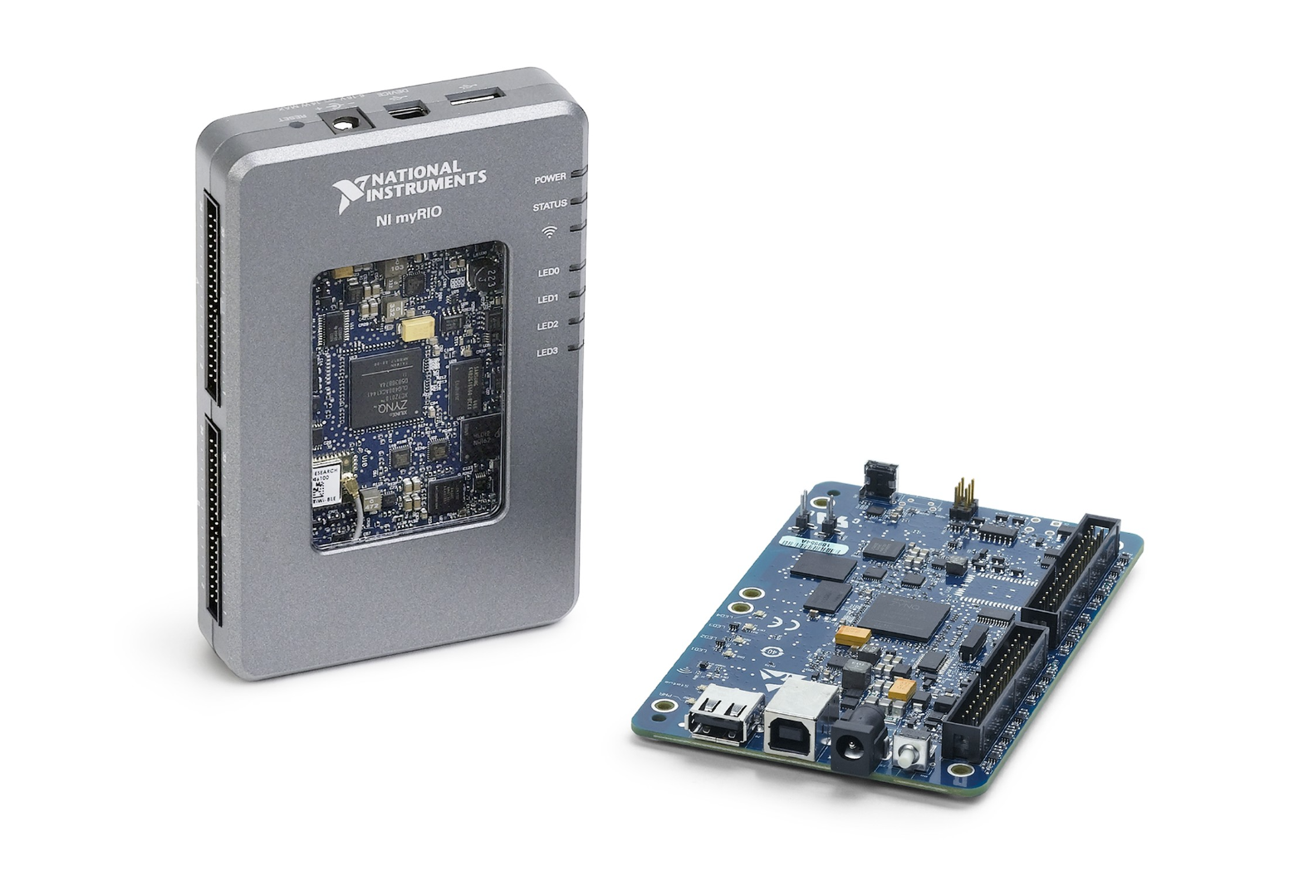

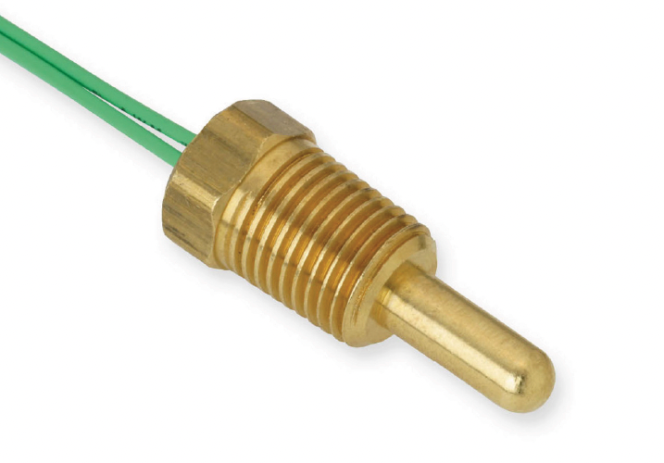
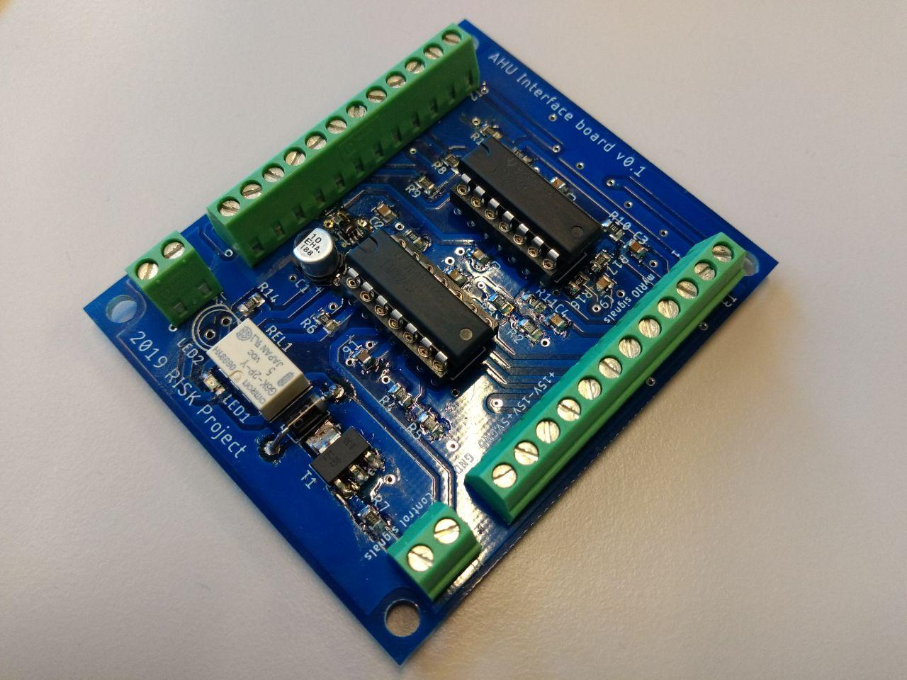
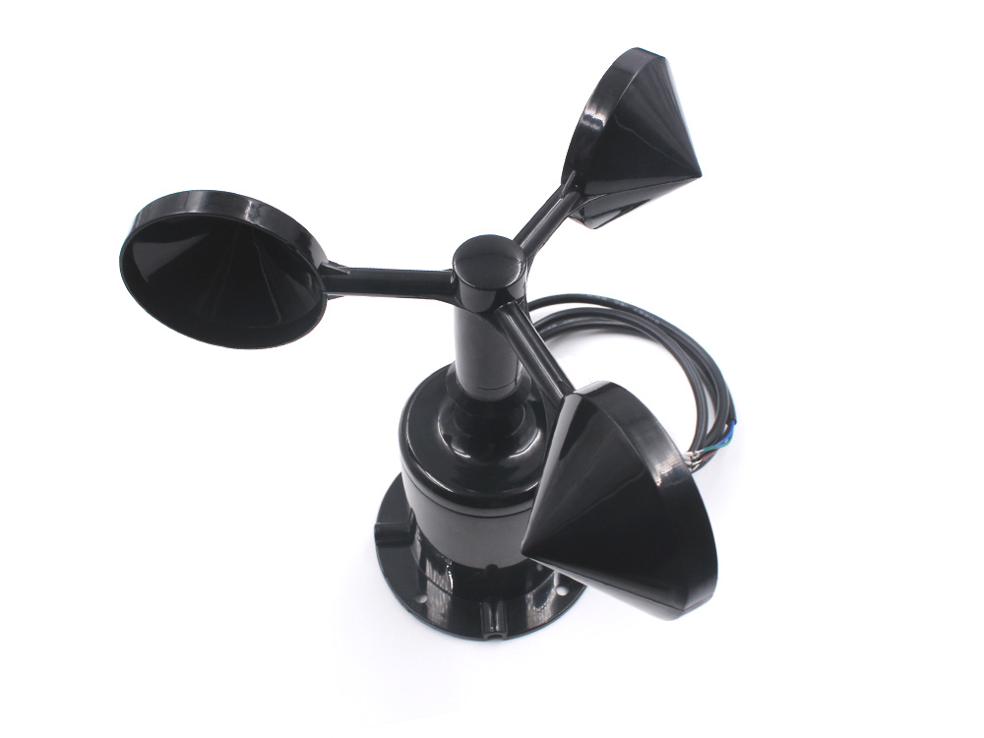
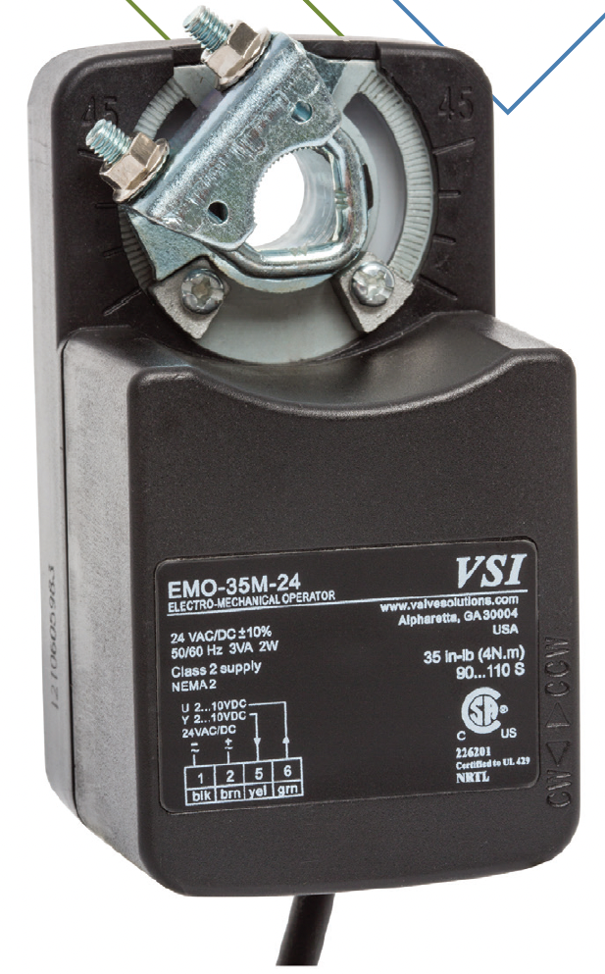
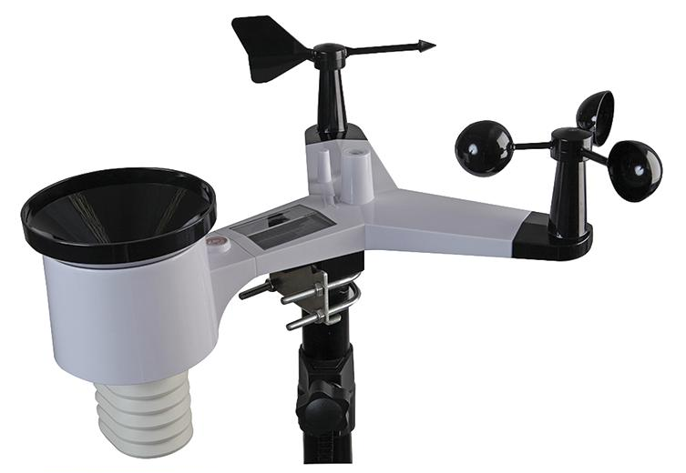


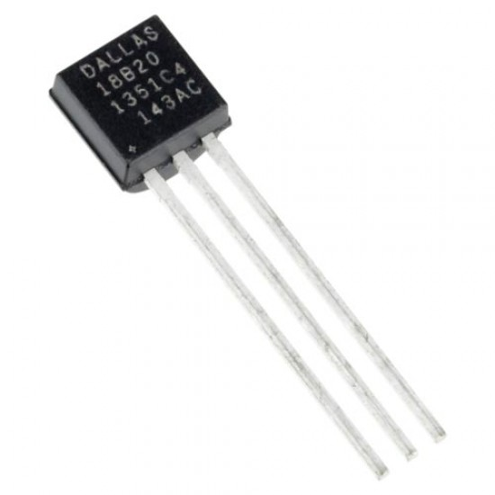
System overview
Water flow sensors (x3)
Thermistor probes (x6)
PHYS.
PHYS.
Disturbances
Anemometers (x3)
myRIOs (x3)
Interface PCB (x3)
Servo motors (x3)
Actuators
Disturbances
Outputs
LAN
Z-WAVE
Weather station
Z-wave sensors + Temp. probes (x10)
Mac Mini
Notes:
The local controllers are nothing but myRIO boards, programmed in LabView. For those of you that don’t know, LabView is a graphical language to program embedded platforms like this one.
The myRIOs were responsible for collecting data from a number of sensors: water flow sensors, water temperature probes, anemometers (measuring the air speed), and they were also responsible for driving the servo motors, hence turning the water valves.
Side note, since each of them operated in a sligtly different way, at different voltage levels, etc, I had to design this little PCB to interface the myRIOs and the sensors/actuators. And everything was connected using actual wires, carying out analog signals here and there.
/ /
Aside from that, we also had a weather station sitting on top of the building to measure the outdoor temperature and the solar radiation accurately.
To monitor the indoor temperatures, we deployed some 10 more sensors. We picked Z-wave temperature sensors and attached external temperature probes to them. These are really flexible since they are wireless and can operate autonomously for a couple of months before running out of battery.
Finally a Mac Mini, our main computer, that stored all the data and executed our control algorithms.
/ /
From a control engineering perspective, we could classify the elements you see on your screen as follows:
- The things that measure the system outputs
The things that measure your disturbances (exogenous signals that affect the system dynamics, but are not controlled by you)
And your actuators, the mechanism you have to influence the system
AND That’s all I had to say regarding the HW…

Slide 26
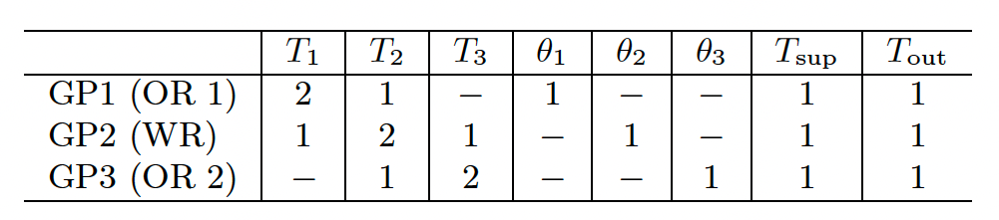
Crafting models
From static functions to (discrete-time) dynamical systems
Non-linear Auto Regressive model
with eXogenous inputs (NARX)
“GP-NARX”
(mean function only)
target
features
Final NARX delays (i.e. GP features) = domain knowledge + hand tuning
Notes:
What did we do with all these data collected from the AHUs and rooms? We built models!
We have already explored GPs, correct? How do we use them to craft models for dynamical systems though?
A discrete-time dynamical system is simply a function predicting the future value of a certain variable as a function of past realizations of it – what is known as the autoregressive property.
If you allow this future value to depend on additional signals, say the position of a valve or the solar radiance, then we say the structure also accounts for exogenous signals.
Lastly, if this relationship F isn’t linear, we say the whole thing is an Nonlinear Autoregressive model with Exogenous Inputs.
/ /
Now if you don’t know F, you learn it from data using a GP… voila, you’ve got a GP-NARX model.
Everything inside the parenthesis is the features of our model, and the target variable is the temperature at the next time-instant.
The actual delays for each signal composing our final feature vectors can be found in the table down below.
That’s what you typically learn in a system identification class.
An extension of such framework is to allow the next variable to depend, not only on the immediately previous one, but on a couple of previous time-instants. That’s what we call an AR model.
Extension number 2, it can also depend on additional variables other than itself. Things we call ‘exogenous inputs’.
Put all that together and you have a NARX model!
If you use a Gaussian process to learn this function f from data, voila, you build your “GP-NARX” dynamical system model.
/ /
Everything that’s inside the parenthesis are the features of that GP, and the next temperature is the target variable. So now you also know how we had to organize your training dataset, right?
In order to choose the right delays
//
T_{i,t+1} = f(&T_{i,t}, T_{i,t-1}, \dots, T_{j,t}, T_{j,t-1}, \dots, \theta_{i,t}, \theta_{i,t-1}, \dots \\
&T_{\text{sup},t}, T_{\text{sup},t-1}, \dots, T_{\text{out},t}, T_{\text{out},t-1}, \dots, R_{\text{sol},t}, R_{\text{sol},t-1}, \dots )

Slide 27
Crafting models
Advanced training details:
Control period of 10 mins, but signals were sampled 5 times faster
Training data consisted of: closed-loop PI, closed-loop RBC, open-loop random, open-loop ramps, etc
Training set = 4491 points (22455 in total)
Notes:
Some more details on the training procedure.
Our sampling period was 10 mins, but everything was sampled 5 times faster to have inter-sample information whenever needed.
31 days of data
/ /
T_{i,t+1} = f(&T_{i,t}, T_{i,t-1}, \dots, T_{j,t}, T_{j,t-1}, \dots, \theta_{i,t}, \theta_{i,t-1}, \dots \\
&T_{\text{sup},t}, T_{\text{sup},t-1}, \dots, T_{\text{out},t}, T_{\text{out},t-1}, \dots, R_{\text{sol},t}, R_{\text{sol},t-1}, \dots )

Slide 28
Crafting models
Advanced training details:
Control period of 10 mins, but signals were sampled 5 times faster
Training data consisted of: closed-loop PI, closed-loop RBC, open-loop random, open-loop ramps, etc
Training set = 4491 points (22455 in total)
Pre-processing: outlier detection, imputation (interpolation), discarding periods of “abnormal operation”
Dropping points too close to each other (Euclidean norm)
Final total number of points: GP1 = 231, GP2 = 308, GP3 = 281
“The most informative subset of a 748-hour period”
Notes:
T_{i,t+1} = f(&T_{i,t}, T_{i,t-1}, \dots, T_{j,t}, T_{j,t-1}, \dots, \theta_{i,t}, \theta_{i,t-1}, \dots \\
&T_{\text{sup},t}, T_{\text{sup},t-1}, \dots, T_{\text{out},t}, T_{\text{out},t-1}, \dots, R_{\text{sol},t}, R_{\text{sol},t-1}, \dots )

Slide 29
Crafting models
Notes:
T_{i,t+1} = f(&T_{i,t}, T_{i,t-1}, \dots, T_{j,t}, T_{j,t-1}, \dots, \theta_{i,t}, \theta_{i,t-1}, \dots \\
&T_{\text{sup},t}, T_{\text{sup},t-1}, \dots, T_{\text{out},t}, T_{\text{out},t-1}, \dots, R_{\text{sol},t}, R_{\text{sol},t-1}, \dots )

Slide 30
Crafting models
Notes:
T_{i,t+1} = f(&T_{i,t}, T_{i,t-1}, \dots, T_{j,t}, T_{j,t-1}, \dots, \theta_{i,t}, \theta_{i,t-1}, \dots \\
&T_{\text{sup},t}, T_{\text{sup},t-1}, \dots, T_{\text{out},t}, T_{\text{out},t-1}, \dots, R_{\text{sol},t}, R_{\text{sol},t-1}, \dots )

Slide 31
Crafting models
Notes:
T_{i,t+1} = f(&T_{i,t}, T_{i,t-1}, \dots, T_{j,t}, T_{j,t-1}, \dots, \theta_{i,t}, \theta_{i,t-1}, \dots \\
&T_{\text{sup},t}, T_{\text{sup},t-1}, \dots, T_{\text{out},t}, T_{\text{out},t-1}, \dots, R_{\text{sol},t}, R_{\text{sol},t-1}, \dots )

Slide 32
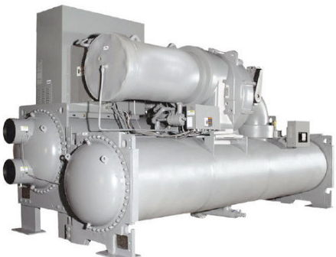
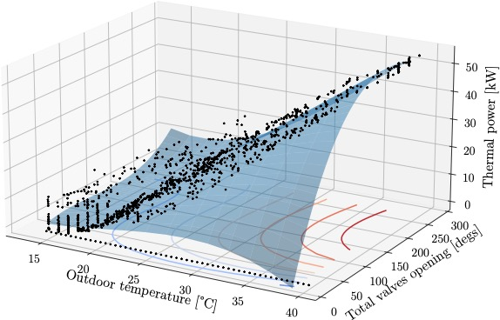
Increasing the thermal load is not always bad…
This is what we care about!
Notes:
11 pts
\text{Q}(T_\text{out},\Theta) = &-3.15 \, T_\text{out} - 3.03 \,e^{-2} \, \Theta + 1.73\,e^{-1} \, T_\text{out}^2 - 1.56\,e^{-3} T_\text{out} \Theta \\
&+ 3.09\,e^{-4} \Theta^2 - 2.75\,e^{-3} T_\text{out}^3 + 4.90 \,e^{-4} T_\text{out}^2 \Theta \\
&- 6.86 \,e^{-5} T_\text{out} \Theta^2 + 2.56 \,e^{-6}\Theta^3 + 20.22
\text{COP}(Q) = 3.30 \, e^{-7} Q^4 - 2.69 \, e^{-5} Q^3 - 2.67 \, e^{-3} Q^2 + 2.34 \, e^{-1} Q^1 - 4.45 \, e^{-4}
E(T_\text{out},\Theta) = Q(T_\text{out},\Theta)/\text{COP}(Q(T_\text{out},\Theta))

Slide 33
The NMPC formulation
Notes:
\min & \quad \sum_{t=0}^{N-1} \left(E_t + \rho \Delta_t \right) + \rho_N \Delta_N\\
\text{s.t.}
& \quad T_{t+1} = \mu(T_t,\theta_t,T_{\text{sup}},T_{\text{out}}) \\
& \quad T_t + \beta \, \text{var}^{1/2} (T_t,\theta_t,T_{\text{sup}},T_{\text{out}}) \leq T_\text{max} + \delta_t \\
& \quad E_t = Q(T_\text{out},\Theta_t) / \, \text{COP}(Q(T_\text{out},\Theta_t)) \\
& \quad \theta_{\text{min}} \leq \theta_t \leq \theta_{\text{max}} \\
& \quad \delta_t \geq 0
\Theta_t = \sum_{i=1}^3 \theta_{t,i}
\Delta_t = \sum_{i=1}^3 \delta_{t,i}^2
\mu = \begin{bmatrix} \mu_1 \\ \mu_2 \\ \mu_3 \end{bmatrix}
\text{var} = \begin{bmatrix} \text{var}_1 \\ \text{var}_2 \\ \text{var}_3 \end{bmatrix}
\delta_t = \begin{bmatrix} \delta_{t,1} \\ \delta_{t,2} \\ \delta_{t,3} \end{bmatrix}
\theta_t = \begin{bmatrix} \theta_{t,1} \\ \theta_{t,2} \\ \theta_{t,3} \end{bmatrix}
T_t = \begin{bmatrix} T_{t,1} \\ T_{t,2} \\ T_{t,3} \end{bmatrix}

Slide 34
The NMPC formulation
Quadratic + linear objective (not all decision vars. included)
Non-linear, loooong, complicated eq. constraints (but smooth)
Non-linear eq. constraint, but easy
Notes:
\min & \quad \sum_{t=0}^{N-1} \left(E_t + \rho \Delta_t \right) + \rho_N \Delta_N\\
\text{s.t.}
& \quad T_{t+1} = \mu(T_t,\theta_t,T_{\text{sup}},T_{\text{out}}) \\
& \quad T_t + \beta \, \text{var}^{1/2} (T_t,\theta_t,T_{\text{sup}},T_{\text{out}}) \leq T_\text{max} + \delta_t \\
& \quad E_t = Q(T_\text{out},\Theta_t) / \, \text{COP}(Q(T_\text{out},\Theta_t)) \\
& \quad \theta_{\text{min}} \leq \theta_t \leq \theta_{\text{max}} \\
& \quad \delta_t \geq 0
\Theta_t = \sum_{i=1}^3 \theta_{t,i}
\Delta_t = \sum_{i=1}^3 \delta_{t,i}^2
\mu = \begin{bmatrix} \mu_1 \\ \mu_2 \\ \mu_3 \end{bmatrix}
\text{var} = \begin{bmatrix} \text{var}_1 \\ \text{var}_2 \\ \text{var}_3 \end{bmatrix}
\delta_t = \begin{bmatrix} \delta_{t,1} \\ \delta_{t,2} \\ \delta_{t,3} \end{bmatrix}
\theta_t = \begin{bmatrix} \theta_{t,1} \\ \theta_{t,2} \\ \theta_{t,3} \end{bmatrix}
T_t = \begin{bmatrix} T_{t,1} \\ T_{t,2} \\ T_{t,3} \end{bmatrix}

Slide 35
The NMPC formulation
Prediction horizon of 12 steps = 2 hours
Total number of decision variables: 9N-4 = 104
Notes:
\min & \quad \sum_{t=0}^{N-1} \left(E_t + \rho \Delta_t \right) + \rho_N \Delta_N\\
\text{s.t.}
& \quad T_{t+1} = \mu(T_t,\theta_t,T_{\text{sup}},T_{\text{out}}) \\
& \quad T_t + \beta \, \text{var}^{1/2} (T_t,\theta_t,T_{\text{sup}},T_{\text{out}}) \leq T_\text{max} + \delta_t \\
& \quad E_t = Q(T_\text{out},\Theta_t) / \, \text{COP}(Q(T_\text{out},\Theta_t)) \\
& \quad \theta_{\text{min}} \leq \theta_t \leq \theta_{\text{max}} \\
& \quad \delta_t \geq 0
\Theta_t = \sum_{i=1}^3 \theta_{t,i}
\Delta_t = \sum_{i=1}^3 \delta_{t,i}^2
\mu = \begin{bmatrix} \mu_1 \\ \mu_2 \\ \mu_3 \end{bmatrix}
\text{var} = \begin{bmatrix} \text{var}_1 \\ \text{var}_2 \\ \text{var}_3 \end{bmatrix}
\delta_t = \begin{bmatrix} \delta_{t,1} \\ \delta_{t,2} \\ \delta_{t,3} \end{bmatrix}
\theta_t = \begin{bmatrix} \theta_{t,1} \\ \theta_{t,2} \\ \theta_{t,3} \end{bmatrix}
T_t = \begin{bmatrix} T_{t,1} \\ T_{t,2} \\ T_{t,3} \end{bmatrix}

Slide 36
The NMPC formulation
Tuning parameters: slack cost and robustness margin
Notes:
\min & \quad \sum_{t=0}^{N-1} \left(E_t + \rho \Delta_t \right) + \rho_N \Delta_N\\
\text{s.t.}
& \quad T_{t+1} = \mu(T_t,\theta_t,T_{\text{sup}},T_{\text{out}}) \\
& \quad T_t + \beta \, \text{var}^{1/2} (T_t,\theta_t,T_{\text{sup}},T_{\text{out}}) \leq T_\text{max} + \delta_t \\
& \quad E_t = Q(T_\text{out},\Theta_t) / \, \text{COP}(Q(T_\text{out},\Theta_t)) \\
& \quad \theta_{\text{min}} \leq \theta_t \leq \theta_{\text{max}} \\
& \quad \delta_t \geq 0
\Theta_t = \sum_{i=1}^3 \theta_{t,i}
\Delta_t = \sum_{i=1}^3 \delta_{t,i}^2
\mu = \begin{bmatrix} \mu_1 \\ \mu_2 \\ \mu_3 \end{bmatrix}
\text{var} = \begin{bmatrix} \text{var}_1 \\ \text{var}_2 \\ \text{var}_3 \end{bmatrix}
\delta_t = \begin{bmatrix} \delta_{t,1} \\ \delta_{t,2} \\ \delta_{t,3} \end{bmatrix}
\theta_t = \begin{bmatrix} \theta_{t,1} \\ \theta_{t,2} \\ \theta_{t,3} \end{bmatrix}
T_t = \begin{bmatrix} T_{t,1} \\ T_{t,2} \\ T_{t,3} \end{bmatrix}

Slide 37
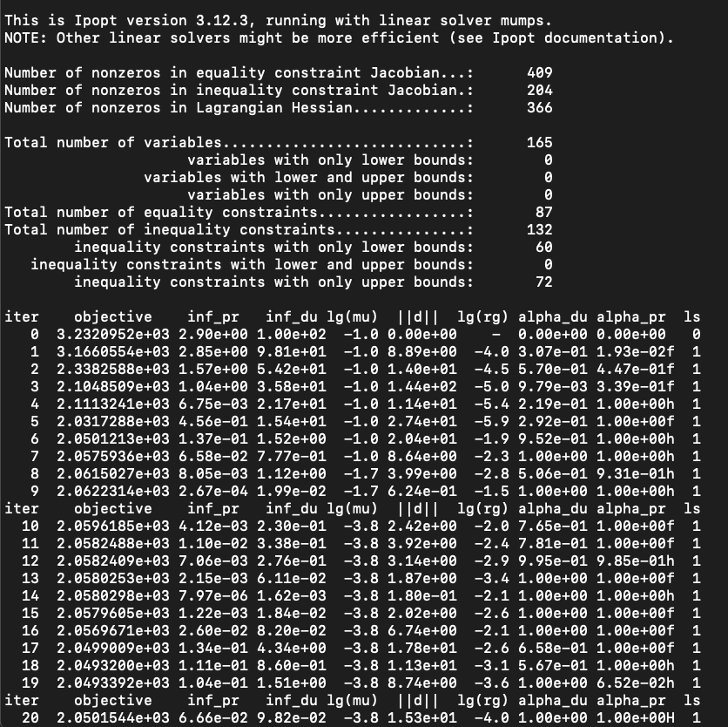
The NMPC formulation
casADi + IPOPT on a 2.4 GHz, core i9 Intel machine
GP data points (total)

Slide 38
Experimental results
Notes:
We’re looking at a 4-day uninterrupted experiment conducted from Nov 10 to Nov 13.
Let me stress that out of the 5184 points, 43 missing entries (temps) that we had to impute. Everything else is precisely as reported by the sensors and the curves you see were NOT pre-processed in any way…

Slide 39
Experimental results

Slide 40
Experimental results

Slide 41
Experimental results
“Fault”
“Fault”
Notes:
You might be thinking, what is this weird behavior? The indoor temperatures are not high, and the valves are saturated at their low values!
If you look up a calendar, you’ll understand why. November 13 was a Saturday, and currently there are no surgeries scheduled for Saturdays. So that section of the building is almost unnocupied…
This truly gives us an idea of how strong the internal heat gains caused by people are in this application.

Slide 42
Comparison among different techniques
Notes:
Energy savings are next.

Slide 43
Comparison among different techniques
The proposed MPC scheme attains quasi-optimal performance!
MPC reduced the energy consumption (monetary cost) by up to 3%
Notes:
Energy savings are next.

Slide 44
Conclusion
Final remarks and future investigations
A complex case-study was presented, featuring multiple zones, strong disturbances, and an industrial forced-air cooling system within a hospital
The approach (GPs combined with MPC) guaranteed the indoor temperature regulation whenever enough actuation power was available with minimized energy consumption
Notes:
Let Assumptions~\ref{as:kernel_spd_compact_X}-\ref{as.norm_bound} hold with $\bar \delta = 0$. Let $s$ be the minimum-norm interpolant $s(x)=\alpha^\top K_{Xx}, \alpha = y^\top K_{XX}^{-1}$. Then, for any $x \in \mathcal{X}$
\label{prop.noise_free_bound}
\begin{empheq}[box={\mymathbox[colback=black!2,drop small lifted shadow, sharp corners]}]{equation}
\label{eq.noise_free_bounds}
\left|s(x) - f^\star(x)\right| \leq P_X(x) \sqrt{\Gamma^2 - \rknorm{s}^2}
\end{empheq}

Slide 45
Part 3
Learning MPC controllers with pQP
neural networks
Published works:
Maddalena, Specq, Wisniewski, Jones. “Embedded PWM predictive control of DC-DC power converters via piecewise-affine neural networks.” IEEE OJIES (2021).
Maddalena, Moraes, Waltirch, Jones. “A neural network architecture to learn explicit MPC controllers from data.” IFAC World Congress (2020).
Notes:
Mathematically,
Let’s assume you have an underlying function that you want to model, F.
You perform some experiments, collecting some pairs of (x,y), where the ys carry information about F are corrupted by additive noise, which is distributed Normally with zero mean and some standard deviation SIGMA.
GPs are defined following Bayesian statistics principles. Firstly, you specify what is known as a PRIOR for unknown values of F. Something that encapsulates your personal beliefs about it – and yes, that’s subjective.
This PRIOR must be in the form of a Gaussian as well, where you can specify its mean and covariance.
Next, in combination with your data, you apply Baye’s rule (Baye’s theorem) to derive the POSTERIOR expression for F – which then defines your Gaussian process.
The beauty of GPs is that this step can be carried out analytically, and there’s almost no other setting in which this is true. Which means, there are no approximations being made when deriving GPs!
If all of this is unfamiliar to you, just remember the following two equations.
The first defined your nominal predictions, whereas the second will give you the level of uncertainty for that same prediction.
In other words, if we come back to this picture…
- - - -
y_i = f(x_i) + \varepsilon_i, \ i=1,\dots,N
\epsilon_i \sim \mathcal{N}(0,\sigma)
f(x) \sim \mathcal{N}(m(x),k(x))
p(f) = \mathcal{N}(m(x),k(x))
p(f\,|y) = \mathcal{N}(\mu(x),\text{var}(x))
\mu(x) &= m(x) + k_X(x)^\top (K_{XX}+\sigma^2I)^{-1}(y-m_X)
\text{var}(x) &= k(x,x) - k_X(x)^\top (K_{XX}+\sigma^2I)^{-1} k_X(x)

Slide 46

Introduction
The idea: Using tailored pQP activation functions as a bias in MPC learning via neural networks.
Motivation: Find simplified yet faithful representations of MPC mappings -> complexity reduction.
Can the user control the approximation complexity?
What level of accuracy can be achieved?
How does it compare to other complex. red. techniques?
Notes:
Goal: introduce kernels and RKHSs

Slide 47
Introduction
The network size is defined by the user.
Goes from to
Always feasible (w.r.t. ) and bounded from below
Goes from to
Ensures control feasibility
Parameters to be adjusted are shown in red.
Notes:
Goal: introduce kernels and RKHSs

Slide 48
Introduction
Intuition behind the proof: L1 and L2 (linear + pQP) learn the (condensed) MPC dual problem, and L3 implements the KKT stationarity condition that maps the optimal dual solution to the optimal primal solution.
L4 is not needed to arrive at the result, indeed, it acts as an identity map. However, it is crucial for deployment.
Once trained, L2 and L4 can be converted into PWA functions -> no need for the online solution of opt. problems.
Closed-loop stability guarantees can be verified a posteriori with mixed-integer programming.
Notes:
Goal: introduce kernels and RKHSs

Slide 49
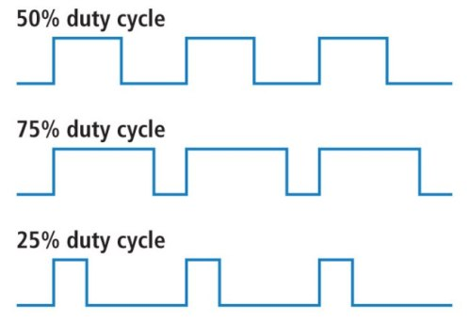

System overview
GOAL: Attain a fast and non-oscillatory start-up response.
current
voltage
duty cycle
Clock: 80 MHz RAM: 128 kB Flash: 1 MB
GD

Slide 50
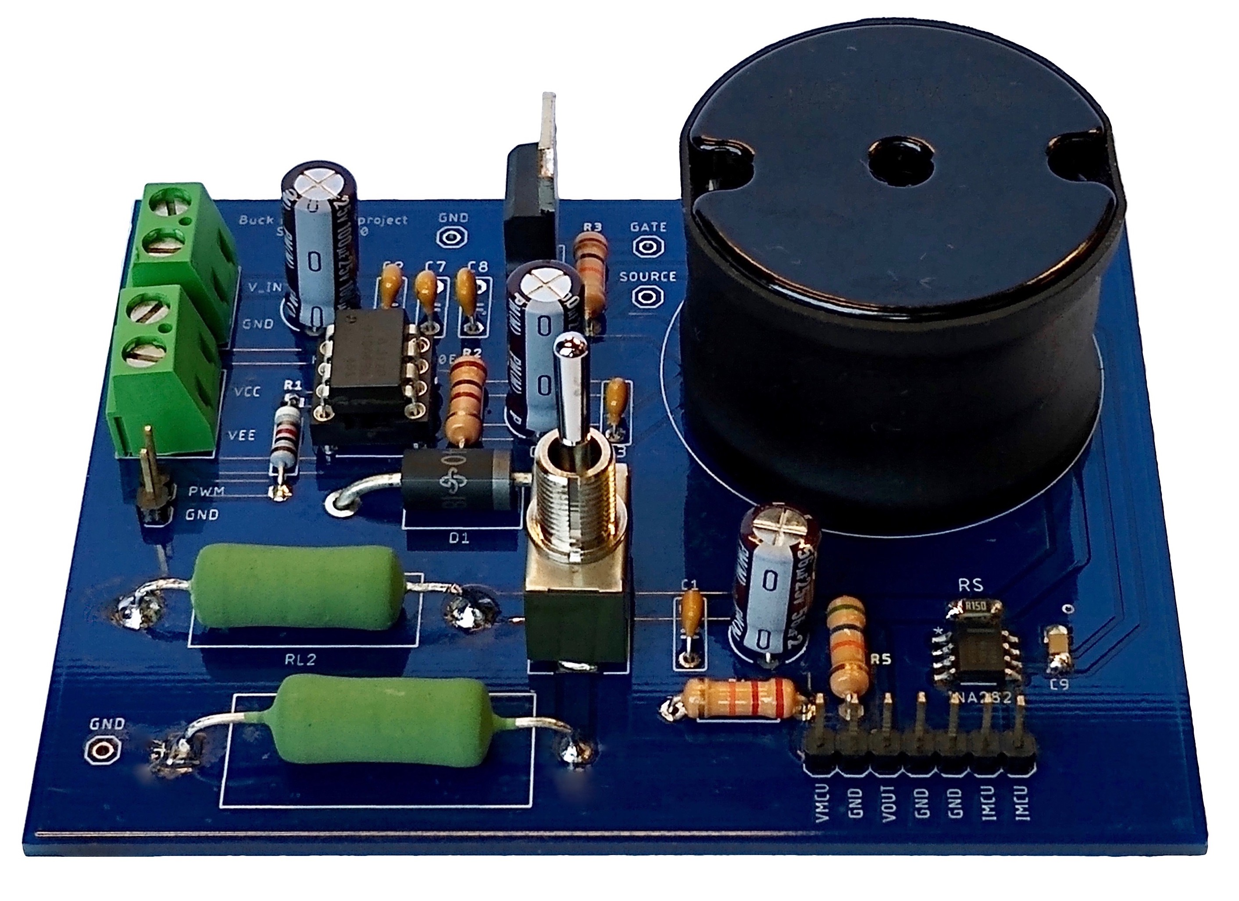
System overview

Slide 51
System overview
Switch
Input DC source
Inductor
Diode
Resistive load
Output capacitors

Slide 52
System overview
Input signal goes here
Current sensor
Voltage sensor
Feedback signals

Slide 53
Obtaining a model
Average dynamics over a switching period:
Linearization around a desired equilibrium point:
+ ZOH discretization
Notes:
x = \begin{bmatrix} x_1 \\ x_2 \end{bmatrix} = \begin{bmatrix} i_L \\ v_O \end{bmatrix}
u = \delta
&\dot x_1 = -\frac{R_L}{L} x_1 - \frac{1}{L} x_2 + \frac{V_{IN}+V_D}{L} u - \frac{R_{ON}}{L} x_1u - \frac{V_D}{L} \\
&\dot x_2 = -\frac{R_C R_O R_L C + R_O L}{(R_C+R_O)LC} x_1 - \frac{R_C R_O C + L}{(R_C+R_O)LC} x_2 + \frac{R_C R_O (V_{IN}+V_D)}{(R_C+R_O)L} u - \frac{R_C R_O R_{ON}}{(R_C + R_O)L} x_1u - \frac{R_C R_O V_D}{(R_C + R_O)L} \\
x_{1eq} = \frac{x_{2eq}}{R_O}
u_{eq} = \frac{R_O V_D + (R_L + R_O) x_{2eq}}{R_O(V_{IN}+V_D) - R_{ON}x_{2eq}}
\dot x = A_{ct}x + B_{ct}u
A_{ct} = \begin{bmatrix} -\frac{R_L + R_{ON} u_{eq}}{L} & -\frac{1}{L} \\[4pt] -\frac{R_C R_O (R_LC - R_{ON}Cu_{eq}+R_{O}L)}{(R_C+R_O)LC} & -\frac{R_C R_O C + L}{(R_C+R_O) LC}\end{bmatrix}
B_{ct} = \begin{bmatrix} \frac{V_{IN}+V_D-R_{ON}x_{1eq}}{L} \\[4pt] \frac{R_C R_O (V_{IN}+V_D-R_{ON}x_{1eq})}{(R_C+R_O)L} \end{bmatrix}

Slide 54
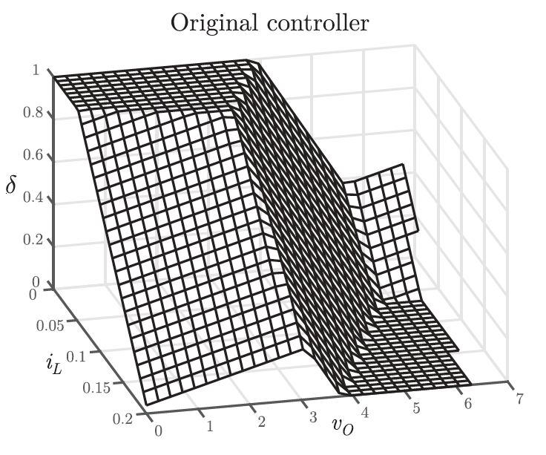
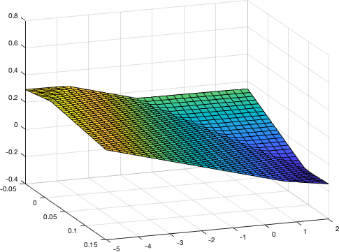
Preprocessing
Standard linear MPC controller designed in MPT3. 5k samples (uniform distribution), nz = 3, weights initialized randomly, 5 re-initializations (35 min of computations each), final MSE loss of 1.66 x 10-7.

Slide 55
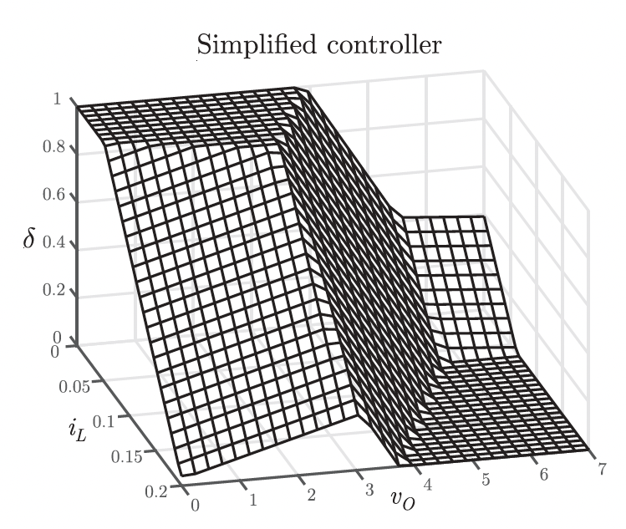
Preprocessing
Standard linear MPC controller designed in MPT3. 5k samples (uniform distribution), nz = 3, weights initialized randomly, 5 re-initializations (35 min of computations each), final MSE loss of 1.66 x 10-7.

Slide 56
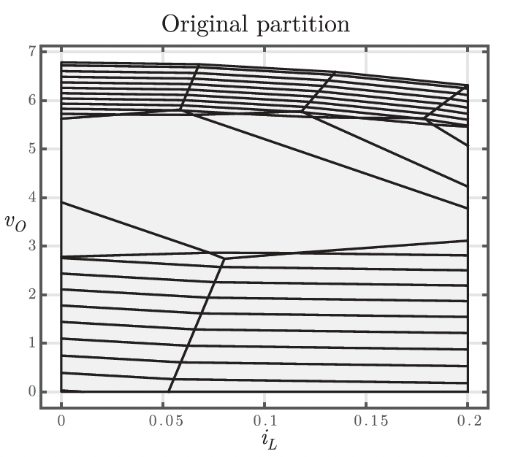
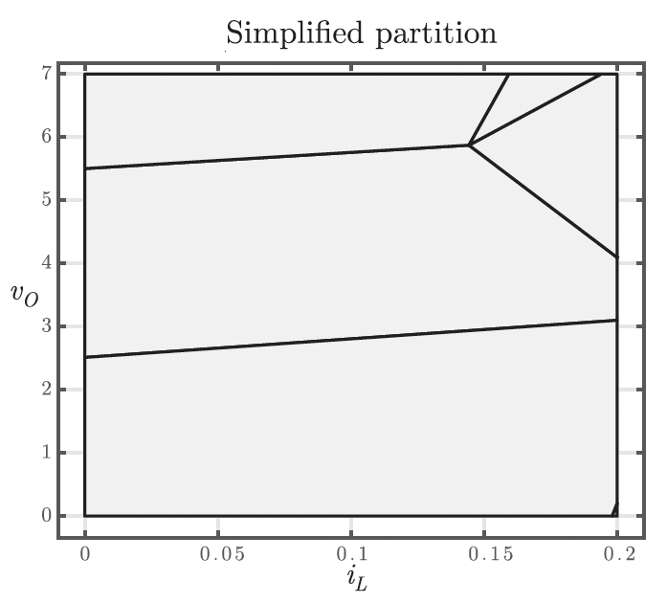
Preprocessing
Number of regions 70 -> 6. Memory footprint 9.25 kB -> 528 B.

Slide 57
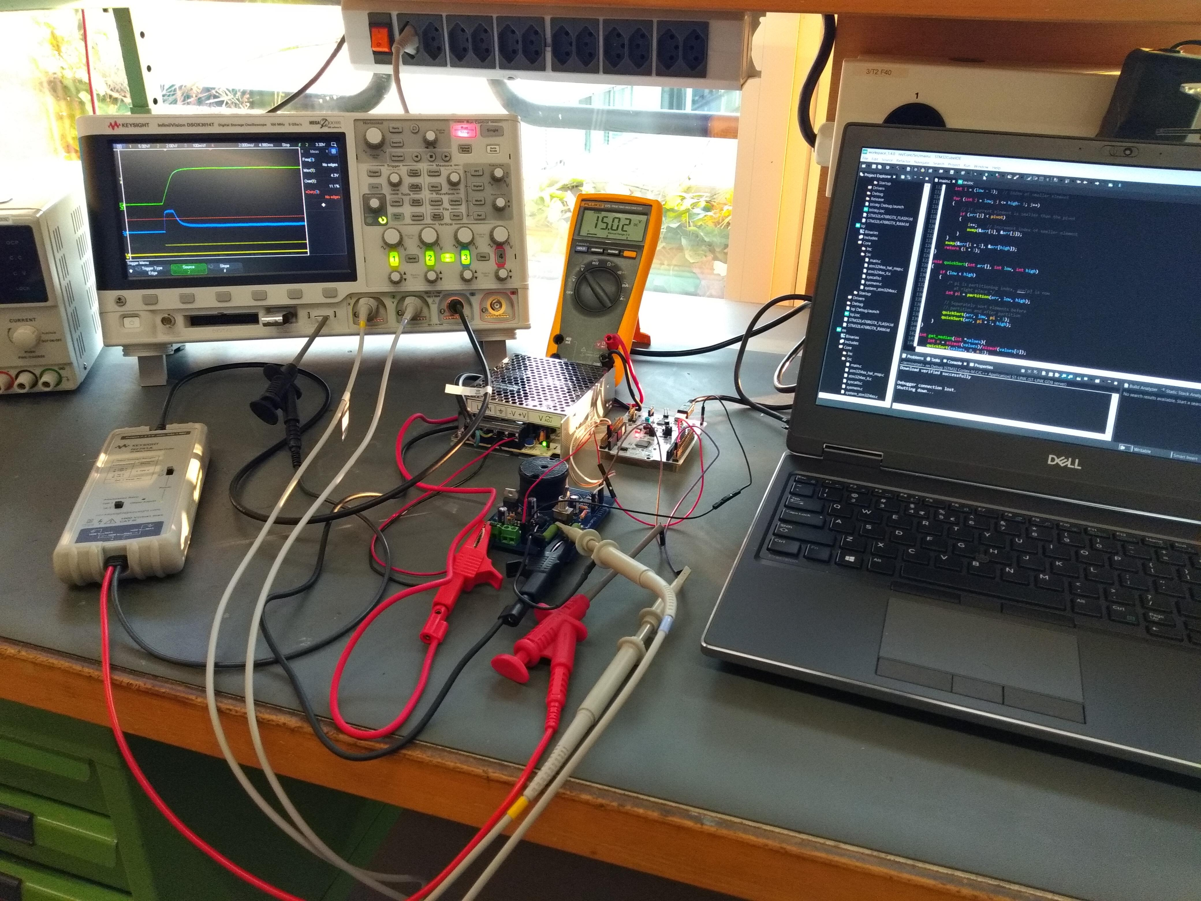
Results
Interrupt-driven code (100 us timer), 2 ADCs + DMA memory transfers, averaging over 8 samples (filtering), no floating-point variables.

Slide 58
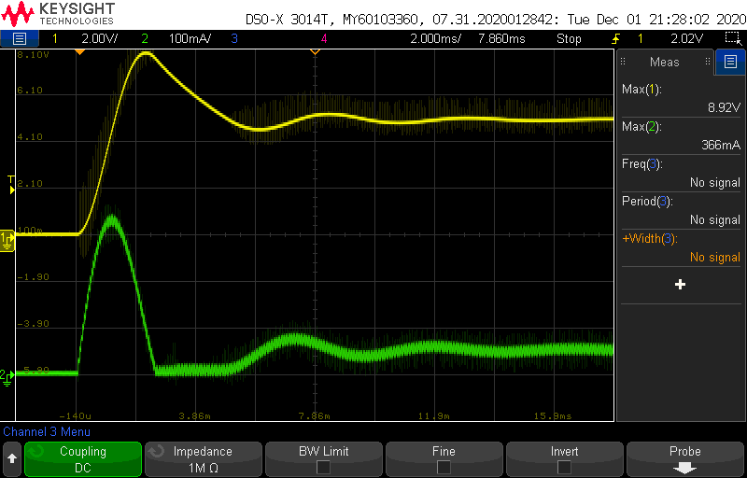
Results

Slide 59
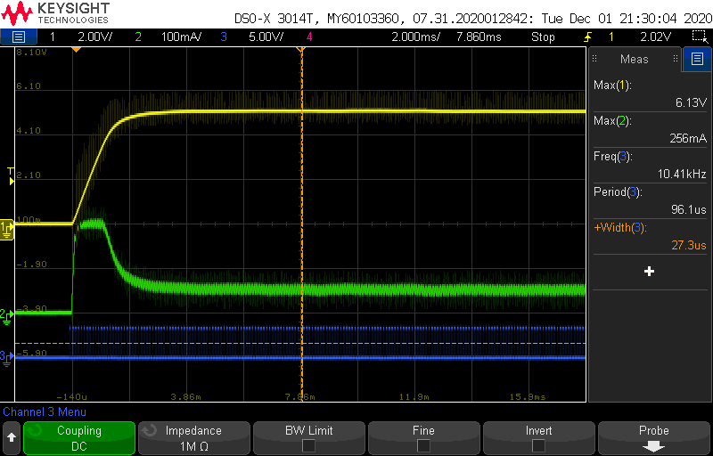
Results

Slide 60
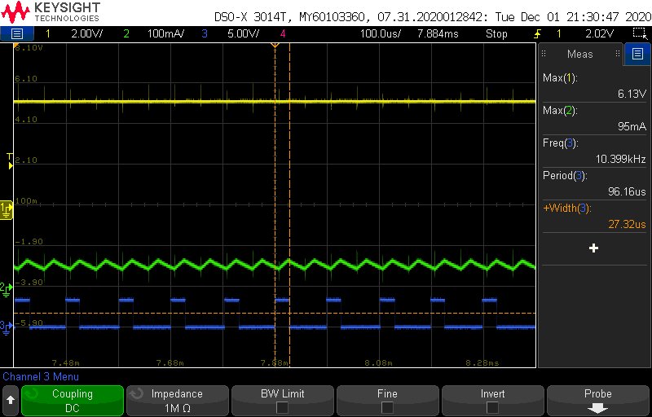
Results

Slide 61
Conclusion
Final remarks and future investigations
Notes:
Let Assumptions~\ref{as:kernel_spd_compact_X}-\ref{as.norm_bound} hold with $\bar \delta = 0$. Let $s$ be the minimum-norm interpolant $s(x)=\alpha^\top K_{Xx}, \alpha = y^\top K_{XX}^{-1}$. Then, for any $x \in \mathcal{X}$
\label{prop.noise_free_bound}
\begin{empheq}[box={\mymathbox[colback=black!2,drop small lifted shadow, sharp corners]}]{equation}
\label{eq.noise_free_bounds}
\left|s(x) - f^\star(x)\right| \leq P_X(x) \sqrt{\Gamma^2 - \rknorm{s}^2}
\end{empheq}

Slide 62
Published works not discussed in this thesis
Chalet, Bujaroska, Germeni, Ghandri, Maddalena, Modi, Olopoenia, Thompson, Togninalli, Briggs.“Mapping the insomnia severity index instrument to EQ-5D health state utilities: A United Kingdom Perspective.” PharmacoEconomics-Open (2023).
Rosolia, Lian, Maddalena, Ferrari-Trecate, Jones. “On the optimality and convergence properties of the iterative learning model predictive controller.” IEEE Transactions on Automatic Control (2022).
Chakrabarty, Maddalena, Qiao, Laughman. “Scalable Bayesian optimization for model calibration: Case study on coupled building and HVAC dynamics.” Energy and Buildings (2021).
Maddalena, Jones. “NSM converges to a k-NN regressor under loose Lipschitz estimates.” IEEE Control Systems Letters (2020).
Maddalena, Jones. “Learning non-parametric models with guarantees: A smooth Lipschitz regression approach.” IFAC-PapersOnLine (2020).
Notes:
Mathematically,
Let’s assume you have an underlying function that you want to model, F.
You perform some experiments, collecting some pairs of (x,y), where the ys carry information about F are corrupted by additive noise, which is distributed Normally with zero mean and some standard deviation SIGMA.
GPs are defined following Bayesian statistics principles. Firstly, you specify what is known as a PRIOR for unknown values of F. Something that encapsulates your personal beliefs about it – and yes, that’s subjective.
This PRIOR must be in the form of a Gaussian as well, where you can specify its mean and covariance.
Next, in combination with your data, you apply Baye’s rule (Baye’s theorem) to derive the POSTERIOR expression for F – which then defines your Gaussian process.
The beauty of GPs is that this step can be carried out analytically, and there’s almost no other setting in which this is true. Which means, there are no approximations being made when deriving GPs!
If all of this is unfamiliar to you, just remember the following two equations.
The first defined your nominal predictions, whereas the second will give you the level of uncertainty for that same prediction.
In other words, if we come back to this picture…
- - - -
y_i = f(x_i) + \varepsilon_i, \ i=1,\dots,N
\epsilon_i \sim \mathcal{N}(0,\sigma)
f(x) \sim \mathcal{N}(m(x),k(x))
p(f) = \mathcal{N}(m(x),k(x))
p(f\,|y) = \mathcal{N}(\mu(x),\text{var}(x))
\mu(x) &= m(x) + k_X(x)^\top (K_{XX}+\sigma^2I)^{-1}(y-m_X)
\text{var}(x) &= k(x,x) - k_X(x)^\top (K_{XX}+\sigma^2I)^{-1} k_X(x)

Slide 63
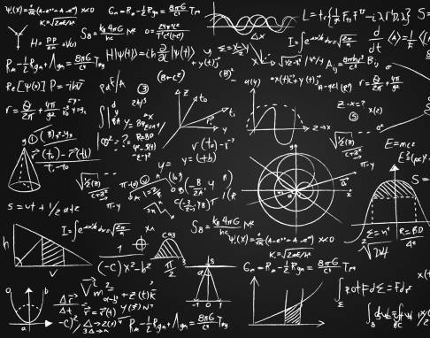
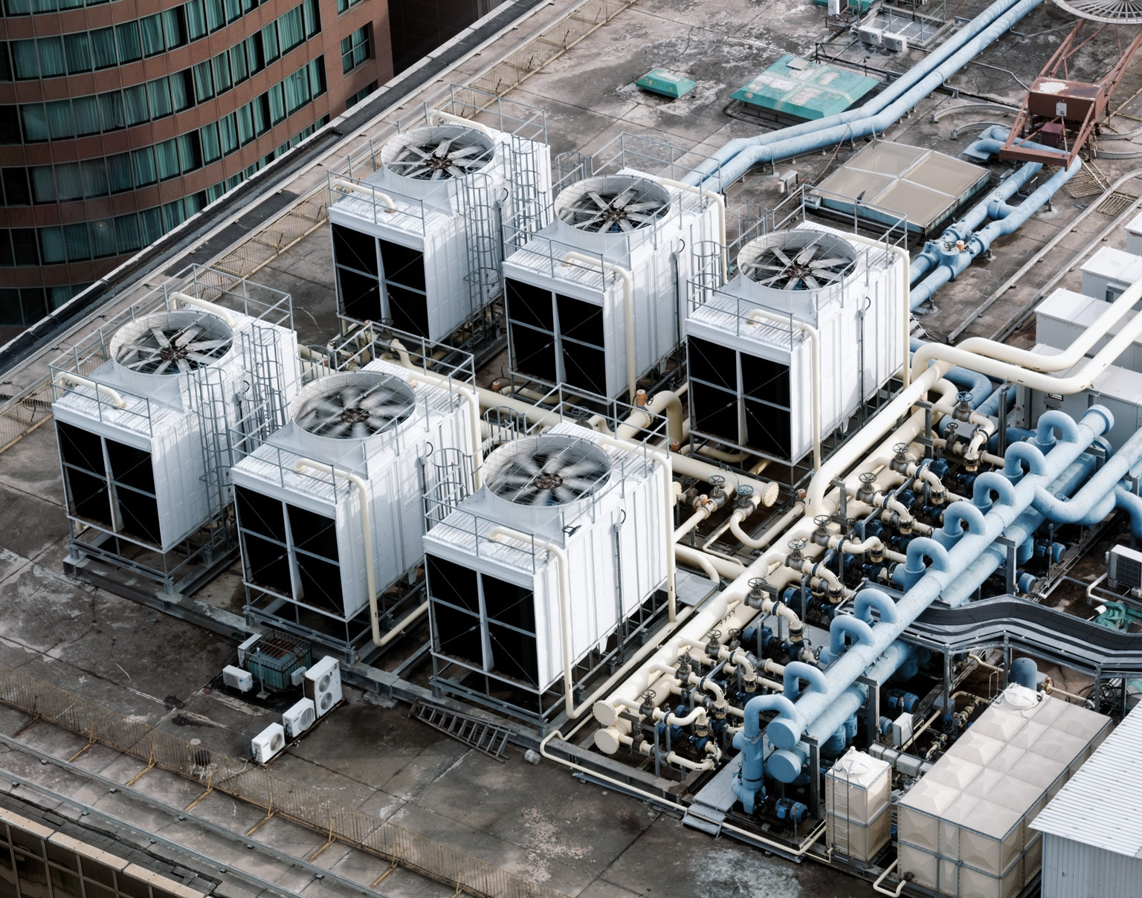

Part 4
Final remarks
Deterministic UQ through kernels
ML methods for HVAC control
MPC complexity reduction for ES
Final output: 7 journal papers and 5 conference papers.

